Slide 1
Introduction to Gradle
Koby aharon
April 2015

Slide 2
A little about me
Developer in the DI lab (iSpreads team)
Joined Citi about 5 months ago
Worked as a build manager in previous job
5+ years of experience with java build tools

Slide 3

Ant
Java based build tool from Apache
Started as part of Tomcat
Moved to a separate project in early 2000
Files are written in XML

Slide 4
Ant - Build file example
<project name="MyProject" default="dist" basedir=".">
<property name="src" location="src"/>
<property name="build" location="build"/>
<property name="dist" location="dist"/>
<target name="init">
<tstamp/>
<mkdir dir="${build}"/>
</target>
<target name="compile" depends="init" >
<javac srcdir="${src}" destdir="${build}"/>
</target>
<target name="dist" depends="compile" >
<mkdir dir="${dist}/lib"/>
<jar jarfile="${dist}/lib/MyProject-${DSTAMP}.jar" basedir="${build}"/>
</target>
</project>

Slide 5
Ant – Pros/Cons
Pros
Very easy to learn.
Full control over the build process.
No “magic”
Cons
Most builds contain huge XML files
Hard to maintain
XML format to write “code”
No convention

Slide 6

Maven
Released in 2004
Introduced dependency management
Introduced multi module concept
Relies on convention over configuration
Declarative over imperative
Uses plugin architecture
Files are written in XML

Slide 7
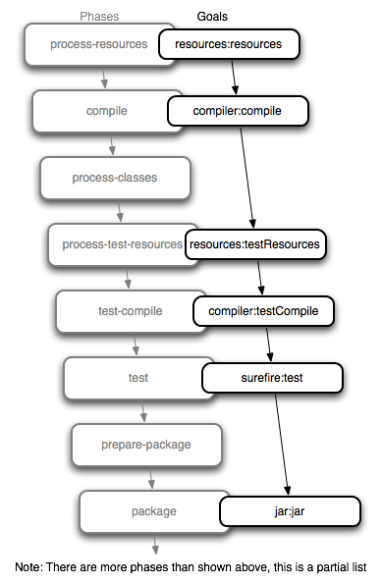
Maven – default (build) lifecycle
Notes:
Maven build life cycles:
1. clean → pre-clean,clean,post-clean
2. default (build)
3. site → pre-site, site, post-site, site-deploy

Slide 8
Maven – POM example
<project xmlns="http://maven.apache.org/POM/4.0.0" xmlns:xsi="http://www.w3.org/2001/XMLSchema-instance" xsi:schemaLocation="http://maven.apache.org/POM/4.0.0 http://maven.apache.org/xsd/maven-4.0.0.xsd">
<modelVersion>4.0.0</modelVersion>
<groupId>org.gradleintro.example</groupId>
<artifactId>example</artifactId>
<version>1.0-SNAPSHOT</version>
<packaging>jar</packaging>
<name>Maven Example POM file</name>
<dependencies>
<dependency>
<groupId>junit</groupId>
<artifactId>junit</artifactId>
<version>4.8.2</version>
<scope>test</scope>
</dependency>
</dependencies>
</project>

Slide 9



why
another
Build
Tool?
Notes:
* Projects today contain a lot of different modules from different languages (polyglot build)
* Both Maven and ant presented key innovations, however today there are more demands from a build tool. (polyglot build, deployment pipelines, etc.)
* Most projects are very different than one another including their build requirements.

Slide 10

Gradle
First released in 2009
Project automation tool
Build upon the concepts of Maven and Ant
Files are written in Groovy using a dedicated DSL

Slide 11
Gradle – build.gradle
apply plugin: 'java'
group = 'org.gradleintro.example'
version = '1.0-SNAPSHOT'
dependencies {
testCompile 'junit:junit:4.11'
}

